Slide 1
IDD Project Implementation
Name of Development

Slide 2
Project Details
Pls provide project information and full list of firms involved.
Project Information
Project Name
Project Title
Location
Development Type
BP Ref No.
Site area
GFA / CFA
Duration (preliminary) and est. TOP
Contract Amount
Project Team Details
Client
Design Architect
Consultants
Main Contractor
Sub-Contractors
Solution providers

Slide 3
Summary of IDD Use Cases for Implementation
The following is an illustration for reference. (Please refer to Annex for definition)
Pls indicate if any use case is specified in tender.
S/N | IDD Use Cases and Innovations | Digital Design | Digital Fabrication | Digital Construction | Digital Asset Delivery & Management
1 | Digital Request for Information (RFI) | ● | ● | ●
2 | Integrated Concurrent Engineering (ICE) meetings | ● | ● | ●
3 | Visualisation and design checks | ● | ● | ●
4 | Digital submission & approval | ● | ● | ●
5 | BIM-based documentation | ● | ● | ●
6 | BIM-based cost estimation | ● | ● | ●
7 | Digital logistics |  | ● | ●
8 | Digital construction scheduling and sequencing |  | ● | ●
9 | Digital progress monitoring |  | ● | ●
10 | Digital QA/QC inspections |  | ● | ●
11 | Digital defects management |  | ● | ● | ●
12 | Digital handover |  |  | ● | ●
13 | Real-time monitoring of assets performance |  |  |  | ●
14 | Digital operations and maintenance |  |  |  | ●
15 | Any other use cases beyond the 14 essential use cases

Slide 4
Summary of IDD Implementation
The following is an illustration for reference. For each use case identified in slide (3), identify key processes for streamlining (e.g. how current/conventional process is done, areas for improving processes, identify to-be process) with help of digital solutions, measurable benefits, issues faced in implementation and learning points.
IDD USE CASE | CURRENT PROCESS (CHALLENGES) | TO-BE PROCESS | DIGITAL SOLUTION / PLATFORM | QUANTIFIABLE BENEFITS | WAY OF MEASUREMENT | ISSUES FACED IN IMPLEMENTATION | LEARNING POINTS
 |  |  |  |  |  | If information is not available at start of project, it can be provided during interim update
1. Digital QA/QC inspections | 1) Paper-based inspection forms 2) Manual data collection 3) Delay corrective actions | 1) reduce paper work & auto-archive inspection records 2) real-time data collection 3)early corrective / preventive actions | digital solution of ABC | % reduction of time spent for inspection approval | Manhours used for preparation and communications of inspections before and after | The platform is not easy to customize the checklist forms | standardise and streamline the checklists before digitalising
2.
3.
4.
…

Slide 5
Digital Use Case XX
Illustrate and deep dive into each IDD key use case, key processes streamlined before and after enabled by digital solutions/ platforms, measurable benefits, issues faced in implementation and learning points (More detailed information can be provided during interim update)
Pls indicate if each digital solution is claimable or non-claimable, depending on whether it is specified in tender.

Slide 6
Calculation of productivity improvement through quantifiable KPIs
S/N | Productivity Improvement (%) | Description of quantifiable KPIs
 |  | Current Implementation | Proposed IDD Implementation
1 | Design
2 | Fabricate
3 | Construct
4 | Asset Delivery and Management
5 | Overall
6 | % Improvement
*Note: Each stage includes collaboration activities such as design coordination between stakeholders
Assumptions

Slide 7
Competency (Project)
Pls illustrate how value chain partners involved benefitted.
List of firms involved | How they benefitted from IDD Implementation e.g. tried xx software, sent personnel to xx training | Which IDD Use Cases are they involved in and what skillsets have they acquired
 | If information is not available at start of project, it can be provided during interim update
Client
Main Contractor
Consultants
Sub-contractors

Slide 8
Competency (Firm)
Pls illustrate how applicant builds up internal core team to be equipped with specific IDD skillsets, to be able to execute future IDD projects.
 | Current IDD Core Team | Future IDD Core Team
No. of employees in IDD Core Team
Relevant skillsets and experience of employees in IDD Core Team
Competency building framework put in place for IDD Core Team |  | e.g. hire more staff with relevant skillsets/experience, send existing staff for training, existing staff obtain DDM Accreditation etc.

Slide 9
Outreach / Best Practices
The following is an illustration, for reference. Show plans how project team plans to document challenges and learning points from projects for sharing.
 | Client | Main Contractor | Design Consultants
Key Learnings from Actual Implementation | Able to form a complete portfolio of digital solutions on a unified platform Better manage project process and information Data analytics and visualization to draw insights from data Improve effectiveness of partnerships and project timelines | Use of digital platforms helped reduce construction time and improved stakeholder collaboration | Use of CDE and collaboration between stakeholders should be in one location (single source of truth) Transitioning to digital workflows of drawing and model approvals and risk management register Management should have vision for using extended teams and workspace mobility
Quantitative Benefits | Faster finalisations of construction details Improved visibility of data throughout building life cycle | Shorter review cycles Time saving in logistics management with BIM-based managed platform Defects identified and rectified faster Inspection approval times reduced Improvement in QC process | Enhanced productivity of project stakeholders by eliminating errors and work duplication in deploying CDE Reduced BIM design changes and fabrication defaults
Qualitative Benefits | Single source of truth for entire building lifecycle Reduced project risk Data collected in CDE can be used to improve subsequent projects performance Improved collaborative relationship of project team | Better visibility on projects and BIM models BIM models, drawings, RFIs, and document submissions by different stakeholders are shared effectively and acted promptly | Able to access and work on documents from anywhere Embrace digital workflows Enable borderless collaboration across extended teams globally

Slide 10
ANNEX
Notes:
We will first share on benefits and value IDD brings to the industry through adopting IDD essential use cases, followed by showcase good practices adopted by leading IDD firms and project.

Slide 11
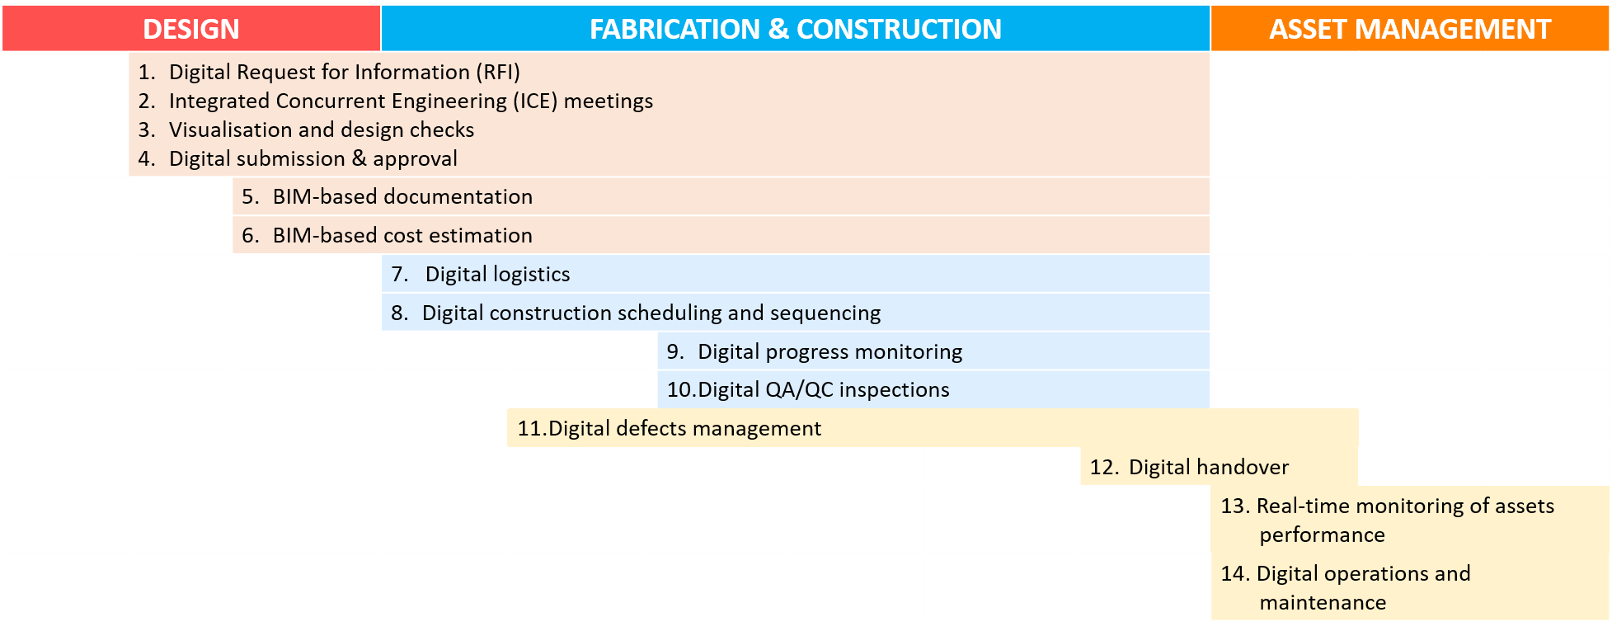
IDD Essential Use Cases
Commonly adopted use cases focus on Design Construction, Fabrication and FM stages

Slide 12
IDD Essential Use Cases
Essential Digital Use Cases across at least 3 project stages for IDD Scope
DIGITAL USE CASE | DEFINITION | DIGITAL DELIVERABLES
Digital Request for Information (RFI) | Use digital technology to request information or facilitate communication, in relation to any issue arising from the building works | Issues and resolution dashboards Digital notes of discussion Updated BIM models
Integrated Concurrent Engineering (ICE) meetings | Conduct an ICE meeting using digital technology and BIM | Digital records of decisions, actions to be taken and party responsible
Visualisation and design checks | Utilise a BIM model, a digital 3 dimensional model or immersive technology to visualise, seek feedback about and validate the design of the building | BIM or other digital 3D models Rendered models
Digital submission & approval | Use digital technology to submit and obtain approval relating to the design of the building or any component involved in the building works | Tracking of design issues, comments, submission, and revisions through digital means Decision records
BIM-based documentation | Prepare documents based on information primarily generated from a BIM model | BIM models Drawings Tender specifications

Slide 13
IDD Essential Use Cases
Essential Digital Use Cases across at least 3 project stages for IDD Scope
DIGITAL USE CASE | DEFINITION | DIGITAL DELIVERABLES
BIM-based cost estimation | Estimate costs at various stages of the building works based on information generated from a BIM model | Costing models Costing and quantity-take-off documentation
Digital logistics | Use digital technology to plan the prefabrication production schedule of the building works, and digitally track and monitor the production, delivery and installation of prefabricated components | Production schedule Digital logistic delivery records
Digital construction scheduling and sequencing | Use digital scheduling to plan and monitor the construction activities of the building works | Construction schedules, and sequencing models
Digital progress monitoring | Use digital solutions or digital scanning to track and monitor the progress of the building works | Records of site progress photos, or scanned models Progress reports (actual vs planned);
Digital QA/QC inspections | Use digital solutions to record the observations from site inspections of the building works and track the necessary follow-up actions taken | Records of QA/QC site inspections; Audit trails of resolution/approvals
Digital defects management | Use digital checklists or digital dashboards to manage and track the defects of the building works and the rectification of those defects | Master defects list Defects rectification reports

Slide 14
IDD Essential Use Cases (FM)
DIGITAL USE CASE | DEFINITION | DIGITAL DELIVERABLES
Digital handover | Use digital technology to generate and digitally handover | Digital asset models Any other documents relating to the physical asset, including but not limited to the following: the as-built records; The manufacturer’s specifications and warranties; the operation and maintenance manuals.
Real-time monitoring of assets performance | Set up a digital platform to monitor the real-time performance and track the key operating parameters of a physical asset that is built as part of the building works | Digital platform for building performance tracking
Digital operations and maintenance | Set up a digital platform to integrate other technologies to perform the operations or maintenance of a physical asset that is built as part of the building works | Digital platform for operations and maintenance

Slide 15
KPIs (Time)

Slide 16
KPIs (Manpower)

Slide 17
KPIs (Quality)

Slide 18
KPIs (Cost)

